Slide 1
Price Elasticity Demand
A Machine Learning Approach

Slide 2

Table Of Contents
Introduction and Business Objective
Price Elasticity – Demand Modelling
Price Elasticity – GAM
Conclusion

Slide 3

Introduction and Business Objective
Price elasticity of demand is a measurement of the change in the demand for a product in relation to a change in its price. Elastic demand is when the change in demand is large when there is a change in price. Inelastic demand is when the change in demand is small when there is a change in price.
Knowing the price elasticity of demand for goods allows retailers to make informed decisions about pricing strategies.
Factors that influence business pricing strategy:
Variation in Season
Level of Demand
Availability of Product
Market Trend
Competitor Price

Slide 4
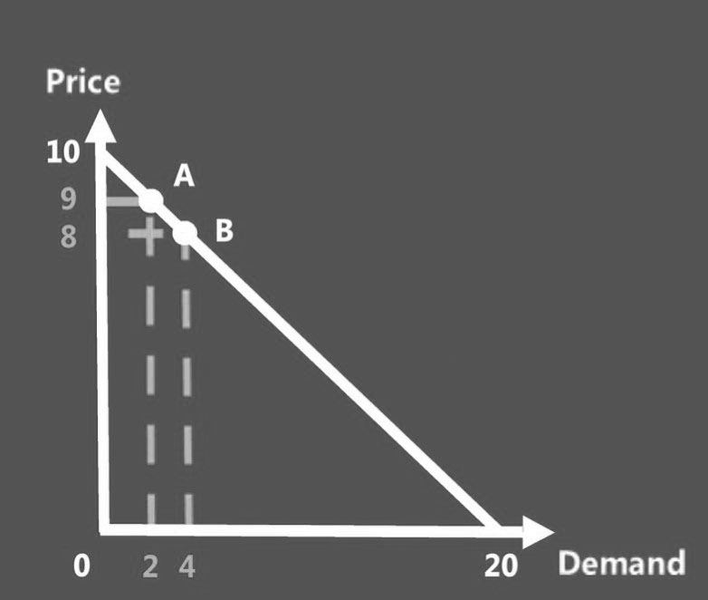
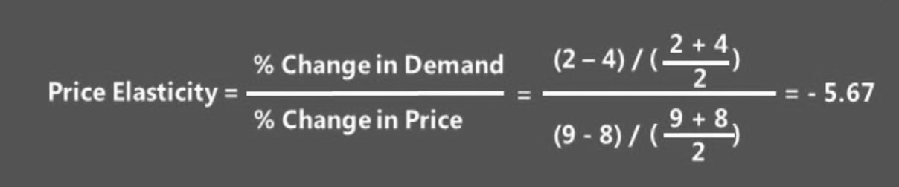
Price Elasticity Formula
We can calculate the price change from 8 to 9 in the Denominator.
The Demand changes 4 to 2 at the Numerator.
So, after calculating the result is: -5.67. That means when there are 1% increase in Price, the demand dropped.

Slide 5
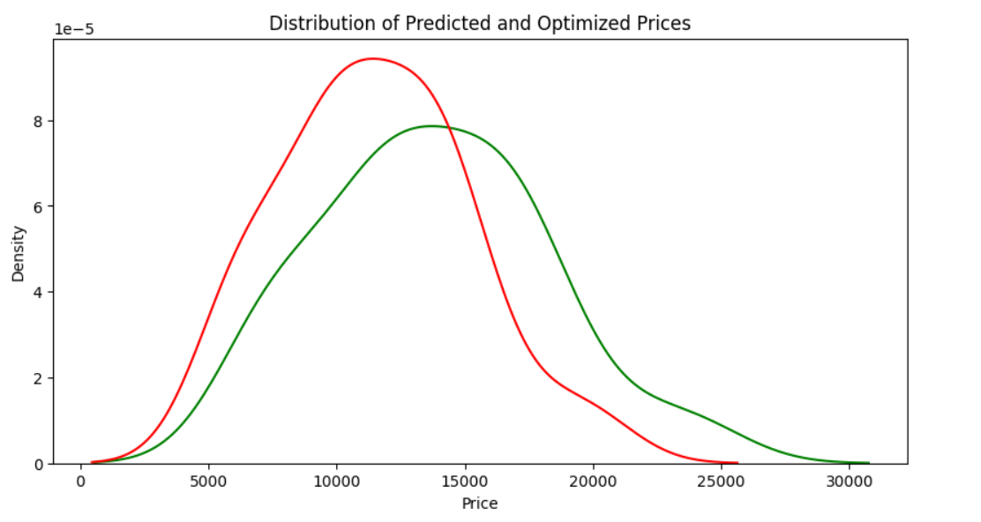


Price Elasticity – Optimization Modelling
DATA SNAPSHOT
OUTPUT / FEATURE IMPORTANCE
OBSERVATIONS
We have used a historical Airline data with featured
1. Duration 2. Price 3. Days Before Flight 4. Arrival 5. Departure Time 6. Time of Arrival 7. Stops 8. Journey Day Name 9. Non-Stop 10. Journey Day 11. Arrival Category 12. Departure Time in Hour Link: https://www.kaggle.com/code/sridharstreaks/airfare-price-prediction/input?select=Scraped_dataset.csv
In our Objective function we define the business goal.:
If the goal is to maximize revenue, then the objective function could be the overall revenue generated from selling tickets to the customers.
Constraints : These are the limitations for real- world price optimization and the requirements that should be considered when to determine the price optimization.
These constraints include maximum & minimum prices of tickets, available inventory, number of seats left, Days left before travel, or any other business constraints related to business.
Revenue before optimization: 378994.97
Revenue after optimization: 454793.96191406244
MODEL USED
XGBoost

Slide 6

Price Elasticity – Demand With GAM
DATA SNAPSHOT
Model Used
Date
Open
High
Low
Close
Volume
Dividends
Stock Splits
GAM Model
Generalized Additive Modeling (GAM) is an extension of regression analysis. The general equation for GAM is as follows:
G(y) = a + b1x1 + f(x2) + f(x3)
In this equation, G(y) is a function of y that varies linearly (or parametrically) with x1, but is dependent on a function of x2 and x3. These functions are essentially cubic spline functions, which are plotted for various knots in the data.

Slide 7
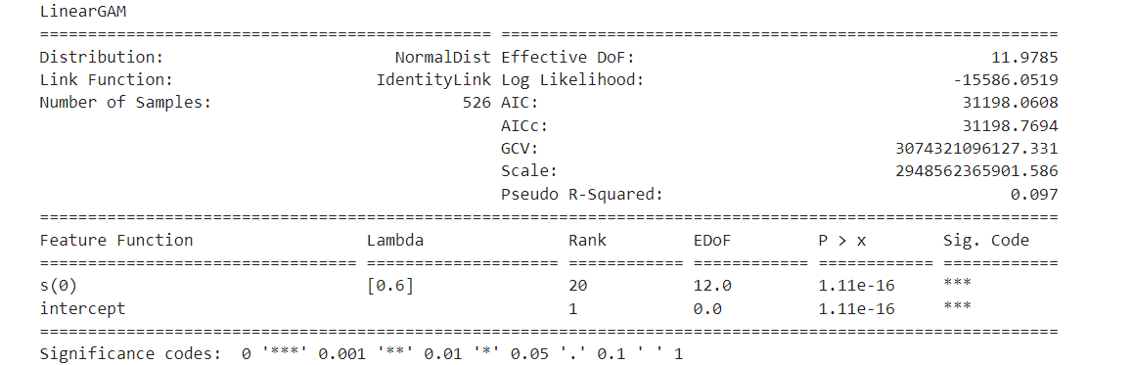
Summary Output & Observation
1. **Distribution**: Indicates the assumed distribution of the response variable, which in this case is a Normal distribution.
2. **Effective Degrees of Freedom (DoF)**: This represents the effective degrees of freedom used by the model, which is around 11.9785. This measures the flexibility of the model in capturing the relationship between the predictors and the response while penalizing for complexity.
3. **Link Function**: Specifies the link function used in the model. Here, it's an Identity Link, which means the linear predictor (the result of the regression equation) directly predicts the response variable.
4. **Log Likelihood**: Indicates the log-likelihood of the model, a measure of how well the model fits the data. A higher log likelihood indicates a better fit.
5. **Number of Samples**: This shows the number of samples (observations) used in the analysis, which is 526 in this case.
6. **AIC (Akaike Information Criterion)** and **AICc (Corrected Akaike Information Criterion)**: These are measures of the relative quality of a statistical model for a given set of data. Lower values indicate a better model fit.
7. **GCV (Generalized Cross Validation)**: Represents the estimated Mean Squared Error (MSE) of the model. It's used as a criterion for model selection, with smaller values indicating better models.
8. **Scale**: Indicates the scale of the model, which is a measure of the variance of the residuals.
9. **Pseudo R-Squared**: Provides a measure of how well the model explains the variance in the data. Here, it's around 0.097, indicating that the model explains approximately 9.7% of the variance in the response variable.

Slide 8
Conclusion
Truly Elastic: The average elasticity across all years is -288, while the average elasticity across all prices between 0 and 50 is -11.6, which is the highest Once the price reaches 100, the trading perception mostly shifts to swing trading, where people buy if the trend is positive and sell if it is negative.
Above 400, the elasticity remains relatively stable, with only a 0.8% variation in volume and a 1% variation in price.
This project allows us to identify relationships between Price and Demand, which in turn will help to :
Maximize revenue by properly pricing the products
Monitor price elasticities for changes in price and demand
Reduce manual processes to obtain and update price elasticities.
Github: https://github.com/ds-stratgic-work/Price-Elasticity-Demand.git

Slide 9


Thank You
dSights is a data tech specialist with a vision to create value through:
Outcome-Oriented AI
Fueled by
Innovative Experimentation

